Slide 1
Redux Saga
Redux Saga essentials
Redux Saga in practice
Defining a simple saga
Defining an asynchronous saga
Calling a REST service

Slide 2
1. Redux Saga Essentials
Overview of Redux Saga
A saga is a generator function
Calling a generator
Using a generator in a loop

Slide 3
Overview of Redux Saga
Redux Saga is a library to help you run "side effects" in your React application, typically asynchronously
E.g. call a REST service
E.g. interact with local storage
E.g. perform a complex calculation
Reasons for using Redux Saga to do this:
Easier to manage, test, and handle errors
3

Slide 4
A Saga is a Generator Function
A saga is a generator function (an ES6 language feature)
The function signature has a *
Inside the function, use the yield keyword to yield control back to the client (optionally supplying a value)
function * ducklingGenerator() {
console.log("\nGenerating duckling #1")
yield "Huey"
console.log("\nGenerating duckling #2")
yield "Luey"
console.log("\nGenerating duckling #3")
yield "Duey"
}
4

Slide 5
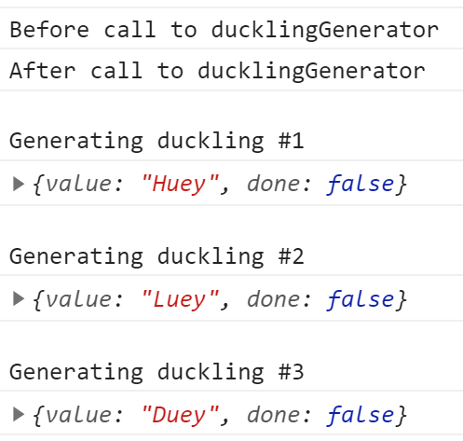
Calling a Generator
Here's some client code, which shows how to use the generator function to get a series of values:
console.log("Before call to ducklingGenerator")
let genObj = ducklingGenerator()
console.log("After call to ducklingGenerator")
let res1 = genObj.next()
console.log(res1)
let res2 = genObj.next()
console.log(res2)
let res3 = genObj.next()
console.log(res3)
5

Slide 6
Using a Generator in a Loop
You can use a generator with a for-of loop
Each iteration returns the next yielded value
When the generator "returns", the loop terminates
for (let res of ducklingGenerator())
console.log(res)
6

Slide 7
2. Redux Saga in Practice
Overview
Example application
Dependencies for Redux Saga
Additional dependencies

Slide 8
Overview
We're now going to see how to use Redux Saga in a full React application
What dependencies are required
How to define a saga
How to add saga middleware into a Redux Store
How to use sagas in realistic scenarios
8

Slide 9
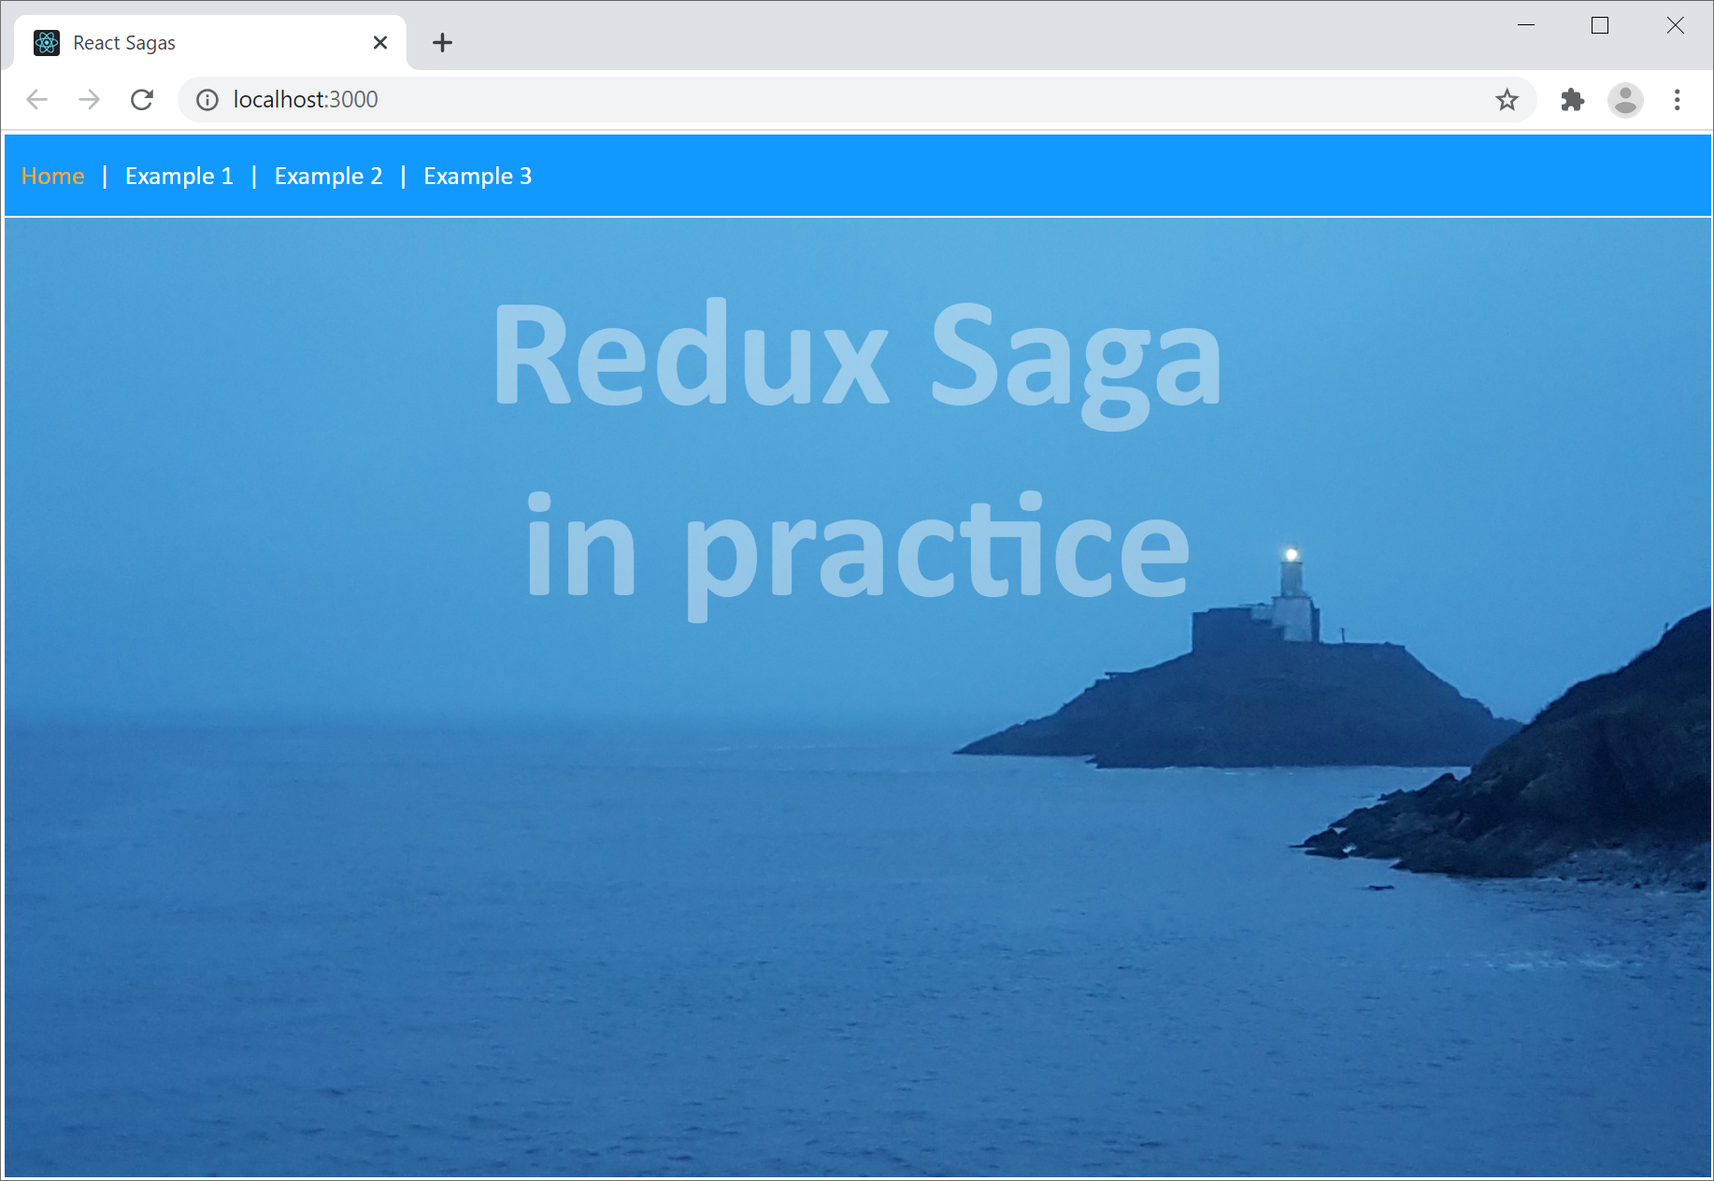
Example Application
Go to the demo-app folder and run
There are 3 examples
Incremental complexity
npm start
9

Slide 10
Dependencies for Redux Saga
To use Redux Saga, add the following dependencies in your package.json file
You can make these changes as follows:
{
"dependencies": {
"redux-saga": "^1.1.3",
"@types/redux-saga": "^0.10.5",
…
},
…
}
Redux Saga
Redux Saga TypeScript declarations
package.json
npm install --save redux-saga [for TypeScript or JavaScript]
npm install --save "@types/redux-saga" [for TypeScript only]
10

Slide 11
Additional Dependencies
Note that the example application also has the following dependencies…
React Redux (required by Redux Saga)
React Router (just to make the example look pretty ☺)
11

Slide 12
3. Defining a Simple Saga
Overview
A simple saga
Creating & running Saga middleware

Slide 13
Overview
In this section we'll see how to define a simple saga
The saga will just display a 1-off message in the console
In the example application, click the Example 1 link
The example has a Redux Store
We've added a "Saga middleware" to the Redux Store
A "Saga middleware" watches for Redux actions, and spawns saga generator functions to handle them
13

Slide 14
A Simple Saga
Example 1 has a super-simple saga ☺
It just displays a message on the console
This isn't a realistic saga
A realistic saga does async work and yields result(s)
But we have to start somewhere!
export function * helloWorldSaga() {
console.log('Hello from helloWorldSaga in Example1!')
}
code/sagas.ts
14

Slide 15
Creating & Running a Saga Middleware
In your root component, create a "Saga middleware", add it to the Redux store, and run it as follows:
import {applyMiddleware} from 'redux'
import createSagaMiddleware from 'redux-saga'
import rootSaga from '../code/sagas'
// Create a Saga middleware, will contain saga(s) that listen for actions.
const sagaMiddleware = createSagaMiddleware()
// Create the Redux Store, and connect the saga middleware to it.
const store = createStore(
myreducer,
{some state we want to put in the Redux Store},
applyMiddleware(sagaMiddleware)
)
// Run our saga in the middleware.
sagaMiddleware.run(helloWorldSaga)
components/Main.tsx
15

Slide 16
4. Defining an Async Saga
Overview
An async worker saga
Triggering a worker saga
Combining sagas into a root saga
Running the root saga

Slide 17
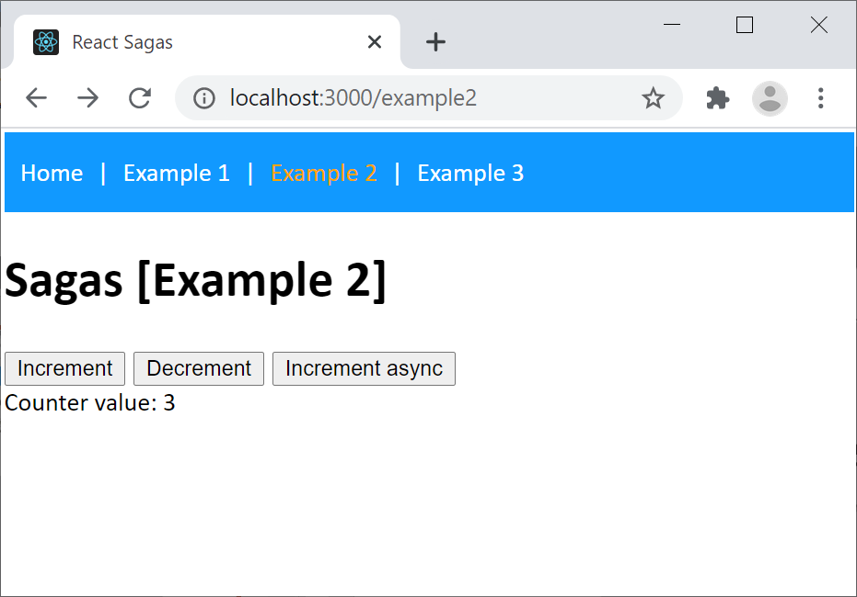
Overview
In this section we'll see how to define an async saga
The saga will delay for a while, then return a value
We'll make use of a Promise to achieve this
In the example application, click the Example 2 link
Click Increment async
Increments counter 3 times, with delays
17

Slide 18
An Async Worker Saga (1 of 3)
Here's our asynchronous "worker" saga
Spawned by Saga middleware (we'll explain how shortly)
It yields value(s) back to the Saga middleware
import {put} from 'redux-saga/effects'
…
const delay = (ms: number) => new Promise(res => setTimeout(res, ms))
function * incrementAsync() {
yield delay(1000)
yield put({ type: ActionType.INCREMENT_COUNTER })
yield delay(1000)
yield put({ type: ActionType.INCREMENT_COUNTER })
yield delay(1000)
yield put({ type: ActionType.INCREMENT_COUNTER })
}
See https://redux-saga.js.org/docs/api/
code/sagas.ts
18

Slide 19
An Async Worker Saga (2 of 3)
Consider the first yield statement:
Calls our delay() function, which returns a Promise
So we're yielding a Promise back to Saga middleware
Saga middleware waits for the Promise to resolve
Then Saga middleware resumes our saga…
const delay = (ms: number) => new Promise(res => setTimeout(res, ms))
…
function * incrementAsync() {
yield delay(1000)
yield put({ type: ActionType.INCREMENT_COUNTER })
…
code/sagas.ts
19

Slide 20
An Async Worker Saga (3 of 3)
Now consider the second yield statement:
Calls put(), an "effect creator function" in Redux Saga
put() creates an effect that tells the Saga middleware to schedule the dispatch of an action to the Redux store
In our example, the action is to increment the counter
import {put} from 'redux-saga/effects'
…
function * incrementAsync() {
yield delay(1000)
yield put({ type: ActionType.INCREMENT_COUNTER })
…
code/sagas.ts
20

Slide 21
Triggering a Worker Saga
The incrementAsync() worker saga on the last few slides increments the counter, with some delays
What causes the worker saga to be spawned…?
The answer is, a "watcher" saga like this:
Handles INCREMENT_COUNTER_ASYNC actions
Spawns incrementAsync() worker saga
function * watchIncrementAsync() {
yield takeEvery(ActionType.INCREMENT_COUNTER_ASYNC, incrementAsync)
}
code/sagas.ts
21

Slide 22
Combining Sagas into a Root Saga
We have multiple "watcher" sagas in our example:
helloWorldSaga()
watchIncrementAsync()
We want all these watcher sagas to start at once
To achieve this, combine the watcher sagas into a single root saga as follows:
export default function * rootSaga() {
yield all([
helloWorldSaga(),
watchIncrementAsync()
])
}
code/sagas.ts
22

Slide 23
Running the Root Saga
We then run the root saga as follows:
import rootSaga from '../code/sagas'
…
const sagaMiddleware = createSagaMiddleware()
const store = createStore(
myreducer,
{counterValue: 0},
applyMiddleware(sagaMiddleware)
)
sagaMiddleware.run(rootSaga)
…
components/Main.tsx
23

Slide 24
5. Calling a REST Service
Overview
Key points in the saga code file
Some interesting questions…

Slide 25
Overview
In this section we'll use a saga to call a REST service
This is one of the main use-cases for sagas
First, run the REST service as follows:
In the server folder, run
Then in the React application:
Click Example 3, then click Get thumbnail URLs async
Calls the REST service asynchronously via a saga
npm start
25

Slide 26
Key Points in the Saga Code File
myRestClient()
This is a regular function, calls the REST service
Returns a Promise, with async result of REST service
getThumbnailUrlsAsync()
Worker saga, calls myRestClient() and awaits result
Yields an effect, telling Saga middleware to process data
watchGetThumbnailUrlsAsync()
Watcher saga, spawns the above worker saga
26

Slide 27
Some Interesting Questions…
Here are some things to think about…
How is the worker saga connected to the UI?
What do we do with the REST result data?
What is the fetch() function doing?
27

Slide 28
Summary
Redux Saga essentials
Redux Saga in practice
Defining a simple saga
Defining an asynchronous saga
Calling a REST service

